Slide 1
Convolutional Neural Implementation From Scratch
Mid Exam Part - B
By: Mayank Sharma, Nikita Sharma, Pranav Joshi

Slide 2
Table of Contents
What is Convolutional Neural Network (CNN) and Pooling Layers ?
CNN Block Diagram.
Computation Graph.
What is Convolution ?
Feedforward Propagation - Backward Propagation.
CNN Architecture.
Working Example.
Colab Notebook and Project gitHub Link.

Slide 3
What is Convolutional Neural Network (CNN)
A Convolutional Neural Network (ConvNet/CNN) is a Deep Learning algorithm which can take in an input image, assign importance (learnable weights and biases) to various aspects/objects in the image and be able to differentiate one from the other.
Convolutional Neural Network (ConvNet/CNN) are preferred over feed-forward neural networks because they are capable of capturing spatial and temporal dependencies in an image through application of filters.
Pooling Layer reduce the number of parameters in image, it basically does, down-sampling or subsampling which reduces the dimensionality of each map but retains important information.

Slide 4
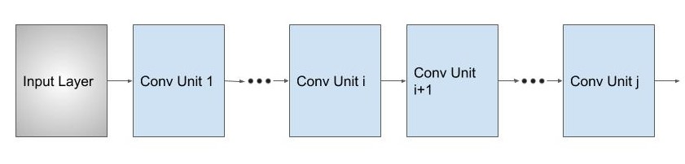
CNN Block Diagram

Slide 5
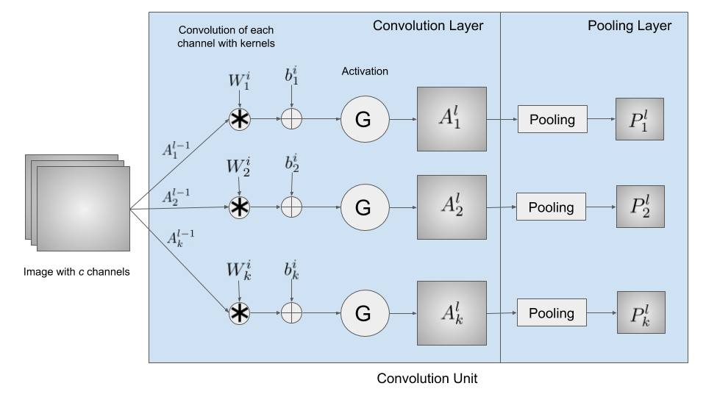
CNN Computation Graph
FC (NN)
S
O
F
T
M
A
X

Slide 6
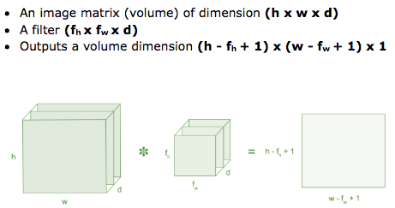
What is Convolution?

Slide 7
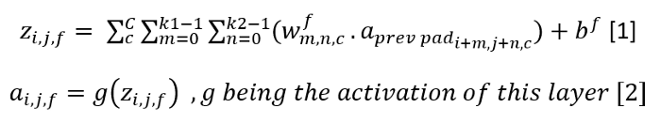
Feed-forward Propagation
Forward propagation (or forward pass) refers to the calculation and storage of intermediate variables (including outputs) for a neural network in order from the input layer to the output layer

Slide 8

Backward Propagation
Backpropagation refers to the method of calculating the gradient of neural network parameters. In short, the method traverses the network in reverse order, from the output to the input layer, according to the chain rule from calculus. The algorithm stores any intermediate variables (partial derivatives) required while calculating the gradient with respect to some parameters

Slide 9
Forward - Backward Pass Illustration

Slide 10
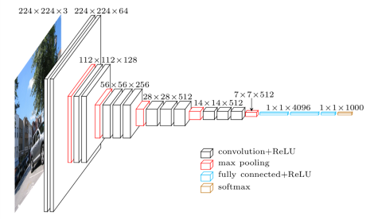
CNN Architecture

Slide 11
CNN Illustration

Slide 12
Colab Notebook And GitHub Link
Project Colab Notebook
Project GitHub
GROUP 2
Mayank Sharma (2019PCS0006)
Nikita Sharma (2019PCS0007)
Pranav Joshi (2019PCS0022)

